Slide 1
Chapter 02

Slide 2
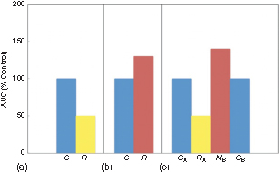
Figure 1 Typical experimental results addressing nonassociative properties of plasma catecholamine responses (expressed as a percentage of controls) of rats exposed to chronic intermittent stress. (a) Habituation of plasma catecholamine responses of repeatedly stressed rats to a mild stressor (R) compared to first-time stressed controls; (b) sensitization of plasma catecholamine responses of repeatedly stressed rats to an intense stressor (R) compared to first-time stressed controls (C); and (c) dishabituation of plasma catecholamine responses of rats repeatedly exposed to stressor A and then presented with a novel stressor B. The plasma catecholamine responses of the A and B controls are presented for comparison. Note that in the same group of chronically stressed animals, the response to a familiar stressor (RA) is diminished compared to the appropriate control (CA), whereas the response to a novel stressor (NB) is enhanced compared to the appropriate control (CB). AUC, integrated area under the curve for plasma catecholamine responses.

Slide 3
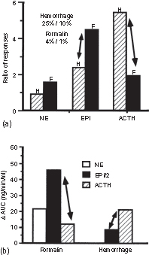
Figure 2 Tests of doctrine of nonspecificity. (a) Ratios (greater stress/less stress) of responses of plasma levels of NE, EPI, and ACTH for hemorrhage (H) and formalin (F). (b) Increments in area under curve (ΔAUC) for plasma NE, EPI, and ACTH for formalin and hemorrhage.
Doctrine of nonspecificity would predict that arrows should be parallel to each other and the same length. Taken from Pacak et al.31 with minor modifications.

